Slide 1
VERGİ GELİRİ TAHMİNİ
EREN KORKMAZ

Slide 2
İÇERİK
VERGİ GELİRİ VERİLERİ
DEĞİŞKEN SEÇİMİ
MODEL SEÇİMİ
EN İYİ TAHMİN MODELİ

Slide 3
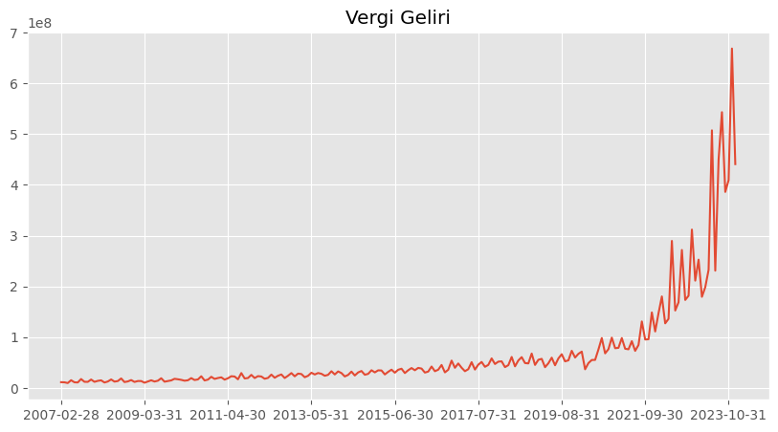

Slide 4
VERGİ GELİRLERİNİ NASIL TAHMİNLİYORUZ?
VERGİ GELİRİLERİNİ ETKİLEYEN DEĞİŞKENLER
KORELASYON
YILLIK TAHMİNLER
MAKİNE ÖĞRENMESİ VE DERİN ÖĞRENME MODELLERİ

Slide 5
KULLANILAN DEĞİŞKENLERLERDEN ÖRNEKLER
Vergi gelirinin 12 ay gecikmeli değeri
Üfenin 12 ay gecikmeli değeri
Tüfenin 12 ay gecikmeli değeri
Doların TL değerinin 12 ay gecikmeli değeri
Altın fiyatının 12 ay gecikmeli değeri

Slide 6
KULLANILAN MODELLER
XGBoost
LSTM
OrthogonalMatchingPursuit
CatBoost
lightGBM

Slide 7
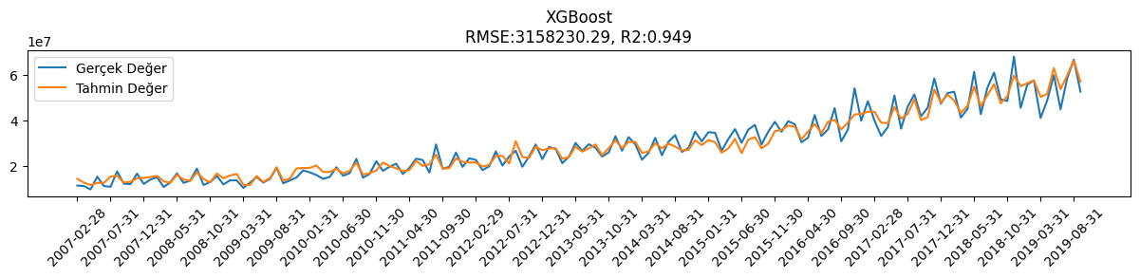
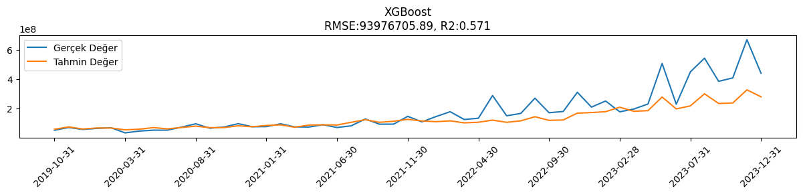

Slide 8
 | Gerçek | Tahmin
2023-01-31 | 252826266 | 180716320
2023-02-28 | 179619616 | 210716256
2023-03-31 | 198589740 | 183150080
2023-04-30 | 232703841 | 187717248
2023-05-31 | 507413997 | 279998208
2023-06-30 | 231158228 | 199392208
2023-07-31 | 450316111 | 219842704
2023-08-31 | 543182902 | 301802784
2023-09-30 | 386223894 | 235985632
2023-10-31 | 409426701 | 239418064
2023-11-30 | 668493162 | 328350080
2023-12-31 | 440911128 | 281412992
2024-01-31 | 517201252 | 308306784
2024-02-29 | 406290761 | 268573472
2024-03-31 | 420467894 | 280008064
2024-04-30 | 487855875 | 325076544
2024-05-31 | 898423555 | 525379776
2024-06-30 | 483125770 | 349573152
2024-07-31 | 611740665 | 505310752
2024-08-31 | 576708862 | 580028800
2024-09-30 | 732243893 | 472336320
2024-10-31 | 643604522 | 502640192
2024-11-30 | 819445921 | 699833856
2024-12-31 | 707754082 | 645171584

Slide 9
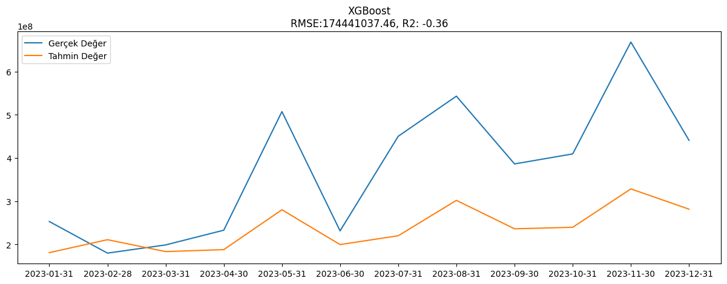

Slide 10
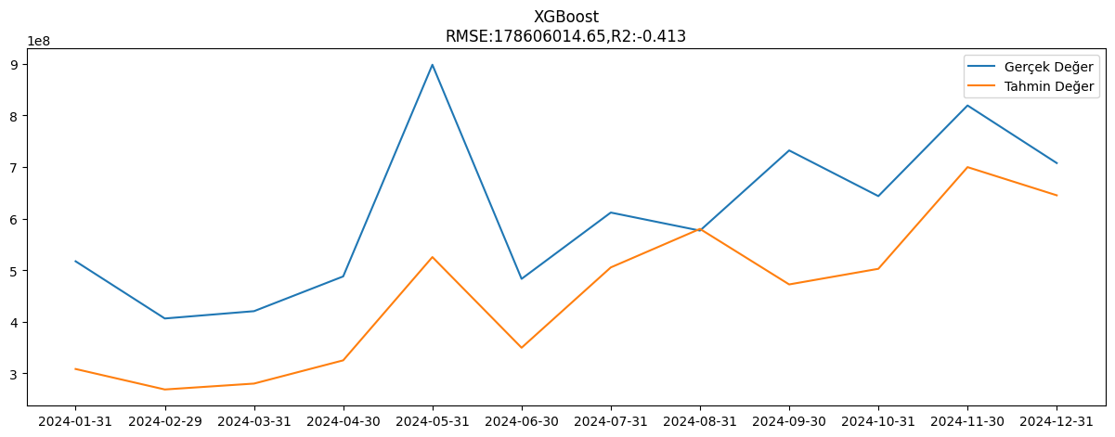

Slide 11
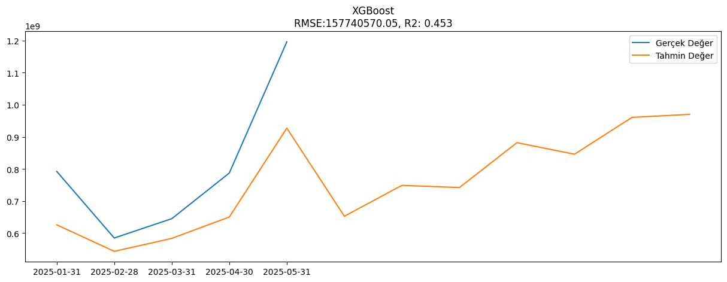

Slide 12
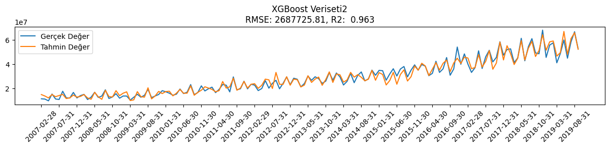
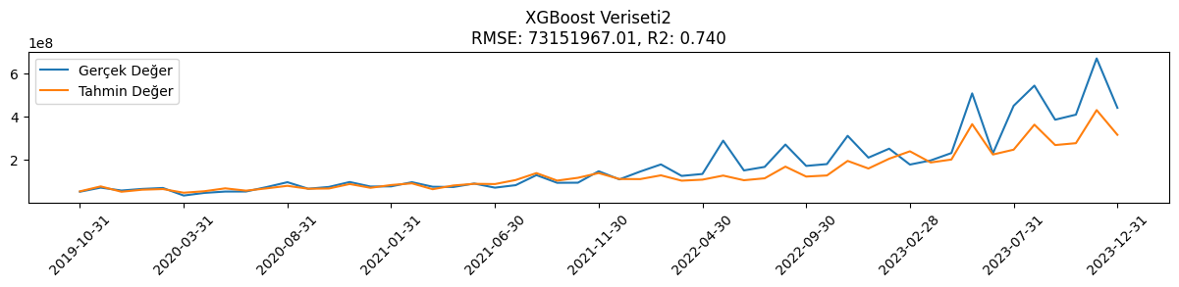

Slide 13
 | Gerçek | Tahmin
2023-01-31 | 252826266 | 206506112
2023-02-28 | 179619616 | 240735424
2023-03-31 | 198589740 | 189258960
2023-04-30 | 232703841 | 202784112
2023-05-31 | 507413997 | 365754240
2023-06-30 | 231158228 | 225963328
2023-07-31 | 450316111 | 248250288
2023-08-31 | 543182902 | 363466688
2023-09-30 | 386223894 | 269438016
2023-10-31 | 409426701 | 278116224
2023-11-30 | 668493162 | 430452704
2023-12-31 | 440911128 | 316614560
2024-01-31 | 517201252 | 369591392
2024-02-29 | 406290761 | 289599360
2024-03-31 | 420467894 | 317191168
2024-04-30 | 487855875 | 360712288
2024-05-31 | 898423555 | 664900736
2024-06-30 | 483125770 | 372541280
2024-07-31 | 611740665 | 616298048
2024-08-31 | 576708862 | 703819008
2024-09-30 | 732243893 | 528506560
2024-10-31 | 643604522 | 565308800
2024-11-30 | 819445921 | 843394432
2024-12-31 | 707754082 | 559146304

Slide 14
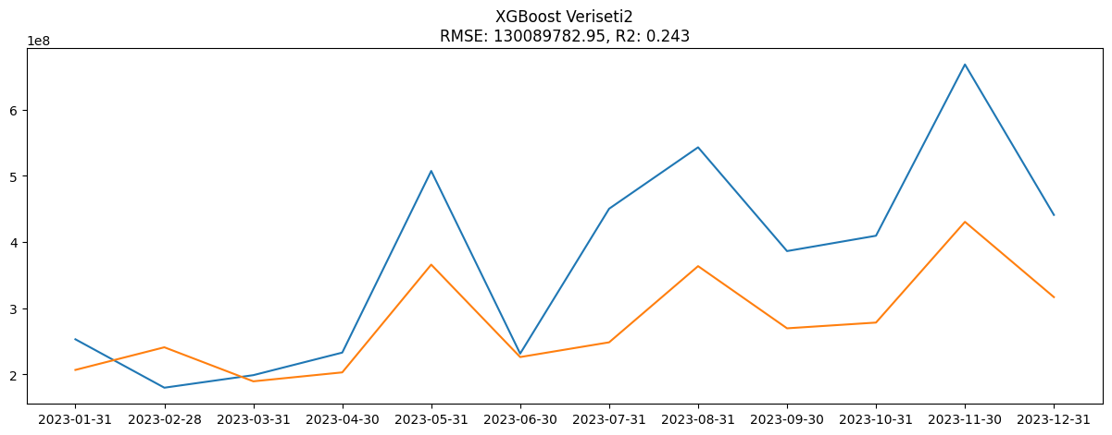

Slide 15
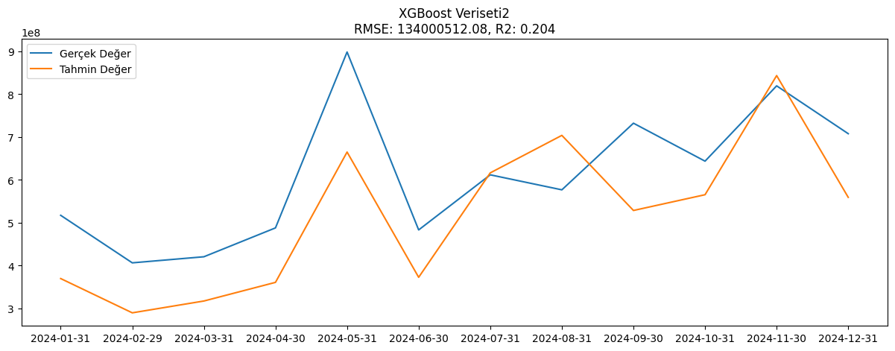

Slide 16
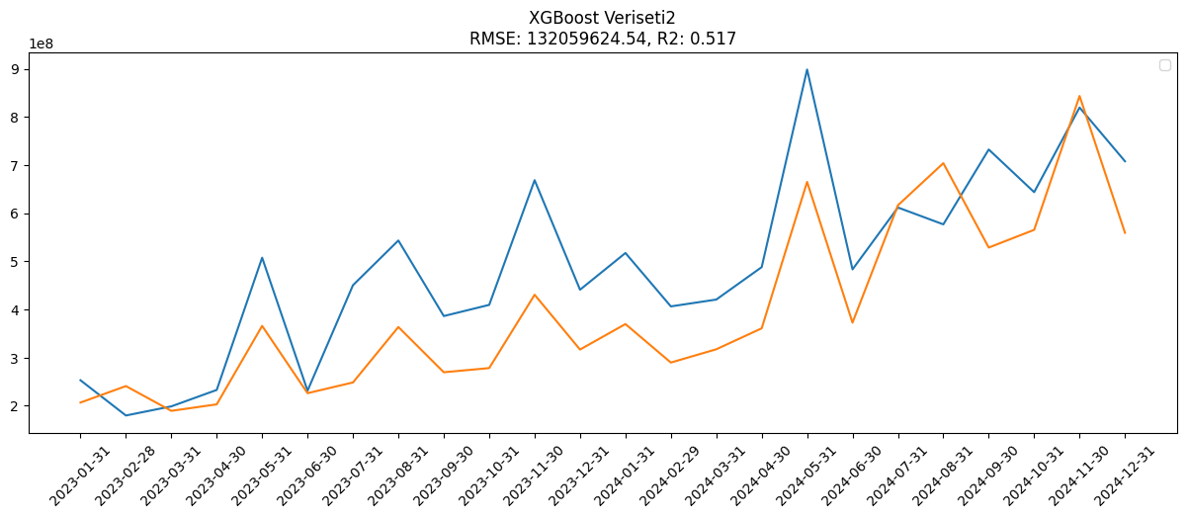

Slide 17
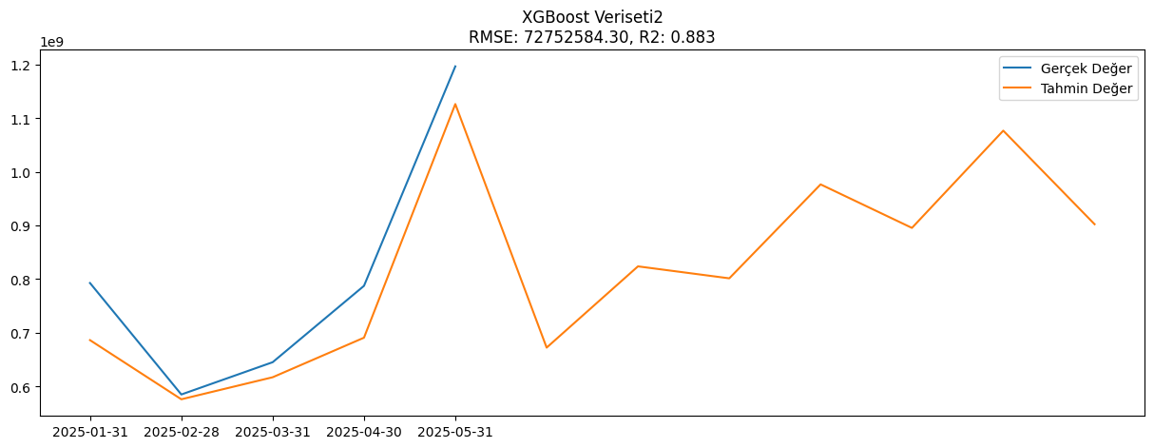

Slide 18
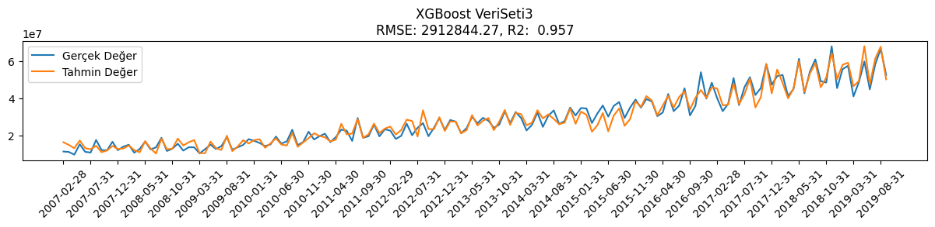
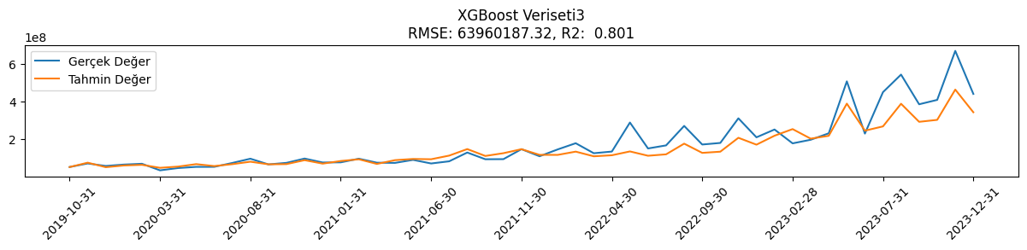

Slide 19
 | Gerçek | TAHMİN
2023-01-31 | 252826266 | 219994848
2023-02-28 | 179619616 | 255009072
2023-03-31 | 198589740 | 204497008
2023-04-30 | 232703841 | 219490720
2023-05-31 | 507413997 | 389591072
2023-06-30 | 231158228 | 246682800
2023-07-31 | 450316111 | 269316576
2023-08-31 | 543182902 | 389003712
2023-09-30 | 386223894 | 293497792
2023-10-31 | 409426701 | 303798080
2023-11-30 | 668493162 | 463849344
2023-12-31 | 440911128 | 343934400
2024-01-31 | 517201252 | 402360032
2024-02-29 | 406290761 | 318852512
2024-03-31 | 420467894 | 350908064
2024-04-30 | 487855875 | 398313984
2024-05-31 | 898423555 | 716717376
2024-06-30 | 483125770 | 413527328
2024-07-31 | 611740665 | 665119424
2024-08-31 | 576708862 | 753123200
2024-09-30 | 732243893 | 568678080
2024-10-31 | 643604522 | 609723008
2024-11-30 | 819445921 | 897029056
2024-12-31 | 707754082 | 589884480

Slide 20
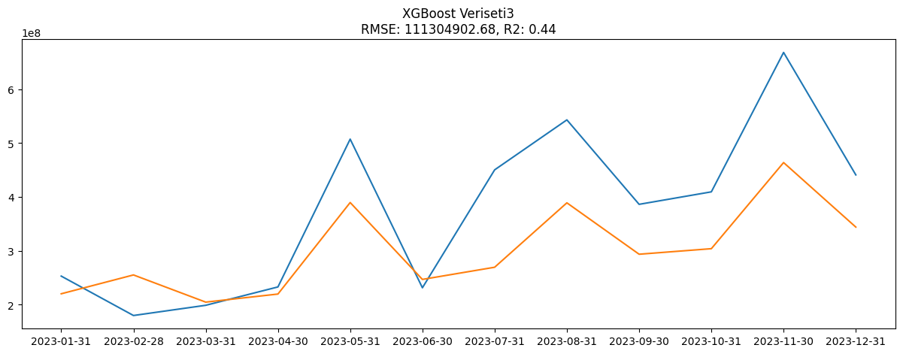

Slide 21
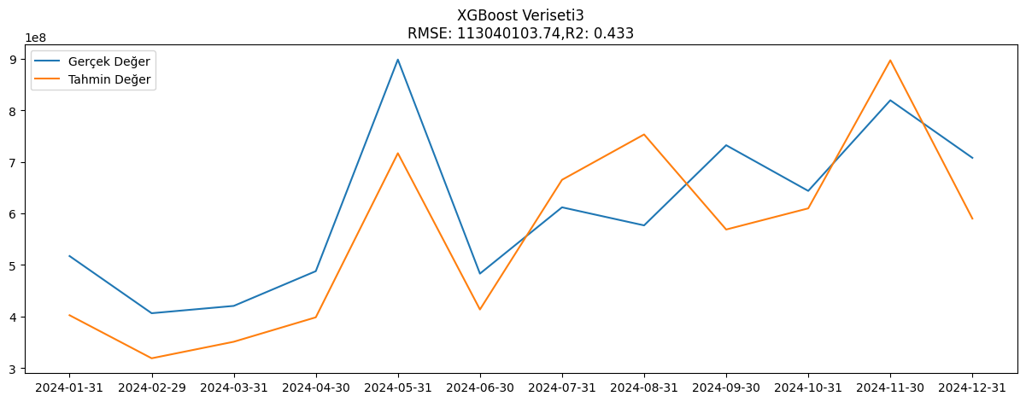

Slide 22
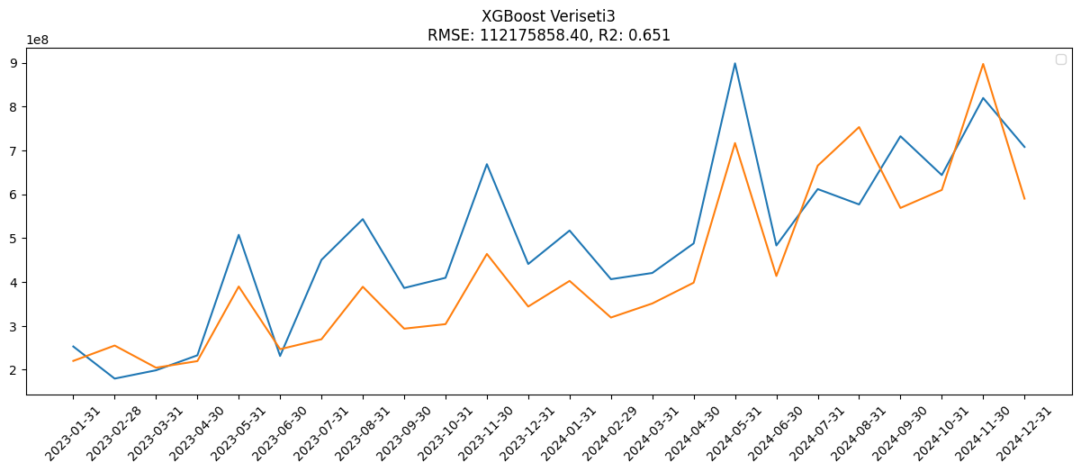

Slide 23
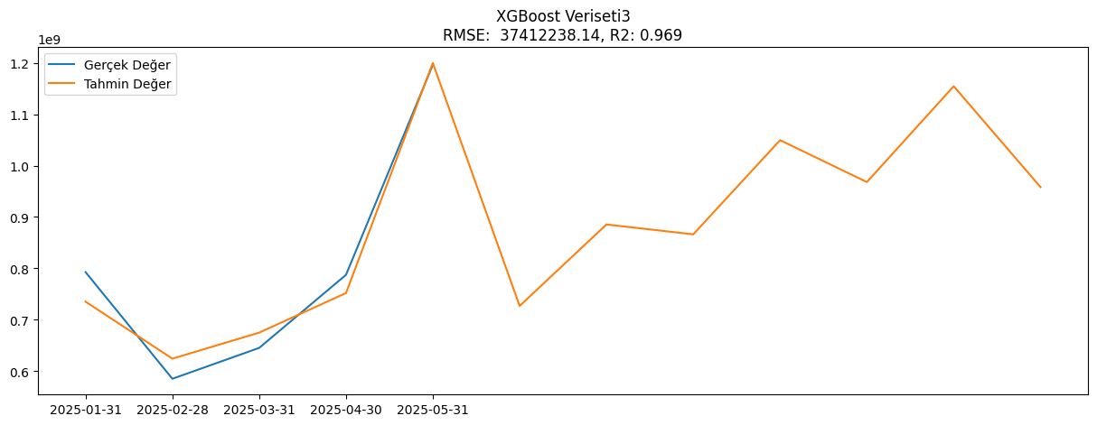

Slide 24
TEŞEKKÜRLER!

